Slide 1
Independent Thinking:
Forming your own opinions using facts, logic & reasoning.
Being Influenced:
Changing beliefs/behaviour due to external pressure — peers, media, trends
What Does It Mean?
INTRODUCTION
ARE WE
INDEPENDENT THINKER
OR
EASILY INFLUENCED
Do we think on our own, or follow others?
Presented By : Samir Parulekar. AIPA-32
Why is it Relevant Today?
We live in the age of:
• Social media algorithms
• Viral trends & peer pressure
• 24/7 information overload
Every day we make choices — but are they truly OUR choices?

Slide 2



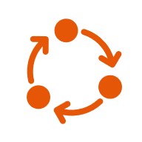
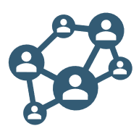
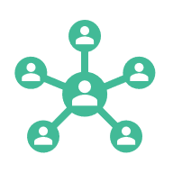
THE POWER OF SOCIAL INFLUENCE
INTRODUCTION
5.6 Billion
What Does It Mean?
Why is it Relevant Today?
People on Social Media world wide
Independent Thinking:
Forming your own opinions using facts, logic & reasoning.
Being Influenced:
Changing beliefs/behaviour due to external pressure — peers, media, trends.
We live in the age of:
• Social media algorithms.
• Viral trends & peer pressure.
• 24/7 information overload.
Every day we make choices — but are they truly OUR choices?
How Social Media Influences Us:
7 Hours
Algorithms show us content we already agree with → creates an echo chamber
Likes & followers create social validation — we post what gets approved
Influencers shape opinions on fashion, politics, health, and lifestyle choices
Average Daily Screen Time
Over 50%
Teens Report Pressure From Social Media

Slide 3



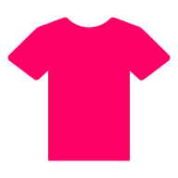
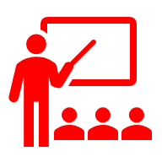




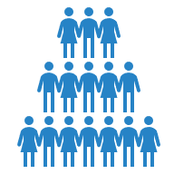
FAMILY, FRIENDS & PEER PRESSURE
THE POWER OF SOCIAL INFLUENCE
5.6 Billion
7 Hours
Over 50%
People on Social Media world wide
Average Daily Screen Time
Teens Report Pressure From Social Media
How Social Media Influences Us:
Algorithms show us content we already agree with → creates an echo chamber.
Likes & followers create social validation — we post what gets approved.
Influencers shape opinions on fashion, politics, health, and lifestyle choices.
Direct Peer Influence
Not All Influence Is Bad
• Dressing like your friend group.
• Picking the same career as peers.
• Watching shows because 'everyone does’.
• Changing opinion to fit the group.
• Avoiding unpopular views to stay accepted.
✅ Positive Influence:
Friends motivating you to study.
Getting inspired to be healthier.
Learning new perspectives.
⚠️ Negative Influence:
Skipping class because others do
Peer pressure to fit in at any cost
Losing your own identity gradually

Slide 4












Your values, goals & identity are authentically yours — not borrowed.
Innovation & Leadership
Personal Growth
WHY INDEPENDENT THINKING MATTERS
FAMILY, FRIENDS & PEER PRESSURE
Critical Decision Making
Resisting Manipulation
You evaluate facts before acting — not just follow trends or pressure.
Direct Peer Influence
Not All Influence Is Bad
• Dressing like your friend group.
• Picking the same career as peers.
• Watching shows because 'everyone does’.
• Changing opinion to fit the group.
• Avoiding unpopular views to stay accepted.
✅ Positive Influence:
You can identify fake news, propaganda & misleading ads more easily.
Friends motivating you to study.
Getting inspired to be healthier.
Learning new perspectives.
⚠️ Negative Influence:
Skipping class because others do
Peer pressure to fit in at any cost
Losing your own identity gradually
Every breakthrough in history came from someone who dared to think differently.

Slide 5




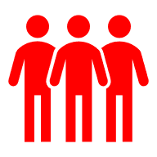
The Exam Preparation Dilemma
REAL-LIFE EXAMPLES
WHY INDEPENDENT THINKING MATTERS
The Viral Trend Trap
Resisting Manipulation
The Opinion Test
Critical Decision Making
03
02
01
You evaluate facts before acting — not just follow trends or pressure.
You can identify fake news, propaganda & misleading ads more easily.
Personal Growth
Innovation & Leadership
Your values, goals & identity are authentically yours — not borrowed.
Every breakthrough in history came from someone who dared to think differently.
A social media challenge goes viral. You follow it without questioning if it's safe, accurate, or ethical — that's being Easily Influenced.
In a group debate, you change your answer when everyone else disagrees — even though you were right. Solomon Asch Conformity Experiment proves this happens to 75% of people.
You plan to study, but your friends say 'No one studies — just chill.' Choosing to study anyway = Independent Thinking.
Ask the Audience: Have you ever changed your opinion just to fit in? Raise your hand!

Slide 6

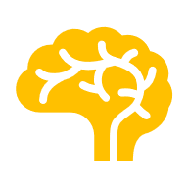


REAL-LIFE EXAMPLES
CONCLUSION & MY OPINION
We are NOT fully independent thinkers — and that's okay, as long as we are AWARE of it. The danger is not influence itself, but unconscious influence. When we know we are being influenced, we can choose to accept or reject it.
01
02
03
My Viewpoint:
The Exam Preparation Dilemma
The Viral Trend Trap
The Opinion Test
You plan to study, but your friends say 'No one studies — just chill.' Choosing to study anyway = Independent Thinking.
A social media challenge goes viral. You follow it without questioning if it's safe, accurate, or ethical — that's being Easily Influenced.
In a group debate, you change your answer when everyone else disagrees — even though you were right. Solomon Asch Conformity Experiment proves this happens to 75% of people.
Ask the Audience: Have you ever changed your opinion just to fit in? Raise your hand!
THINK BEFORE YOU FOLLOW
INFLUENCE IS NATURAL
YOUR VOICE MATTERS
Question trends, news & opinions. Ask: Is this my belief or someone else's?
Humans are social — being influenced is normal.
The key is being conscious of it.
One independent thought can change a conversation, a classroom, or the world.
"Think for yourself — or someone else will do it for you."

Slide 7
CONCLUSION & MY OPINION
My Viewpoint:
We are NOT fully independent thinkers — and that's okay, as long as we are AWARE of it. The danger is not influence itself, but unconscious influence. When we know we are being influenced, we can choose to accept or reject it.
THINK BEFORE YOU FOLLOW
INFLUENCE IS NATURAL
YOUR VOICE MATTERS
Question trends, news & opinions. Ask: Is this my belief or someone else's?
Humans are social — being influenced is normal.
The key is being conscious of it.
One independent thought can change a conversation, a classroom, or the world.
"Think for yourself — or someone else will do it for you."
THANK YOU

Slide 8
THANK YOU !
Presented By : Samir Parulekar. AIPA-32

